Slide 1






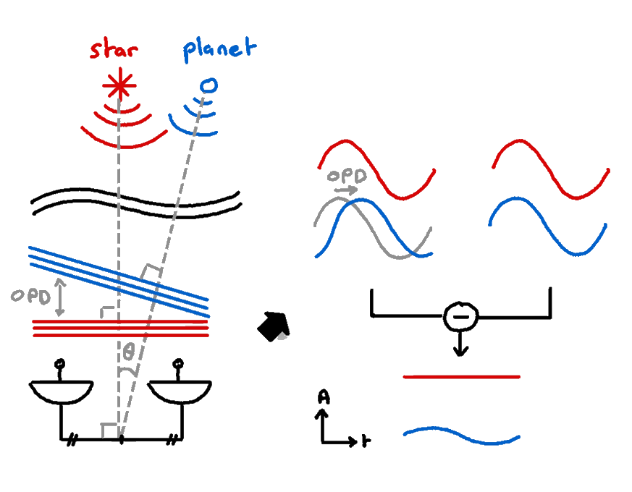

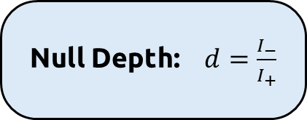
Nulling Interferometry
DIRECT DETECTION OF EXOPLANETS USING TUNABLE KERNEL-NULLING
On-axis signals in phase opposition
Concept of nulling interferometry
📚 Bracewell et al. (1979)
Off-axis source undergo an OPD
Null Depth: $d=\frac{I_{−}}{I_{+}}$
Demonstrated on sky at $d={10}^{−4}$
📚 Norris et al. (2019)
Very sensitive to phase aberration

Slide 2
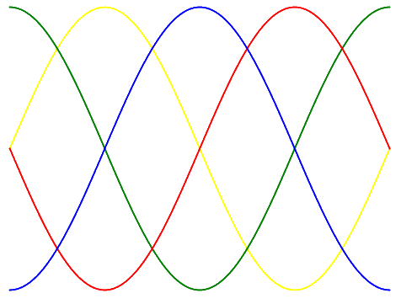
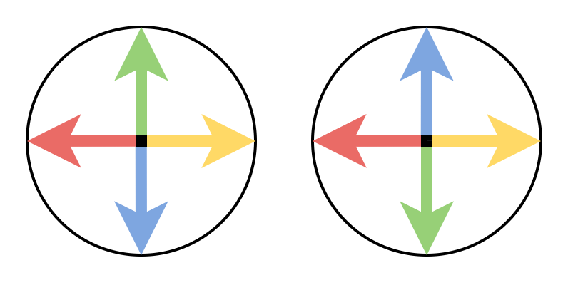
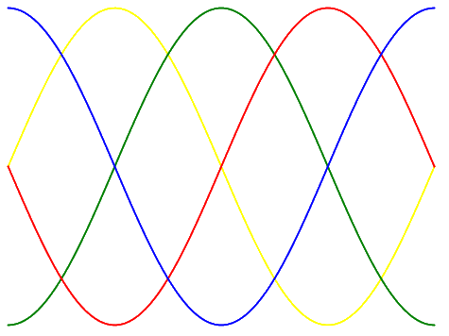
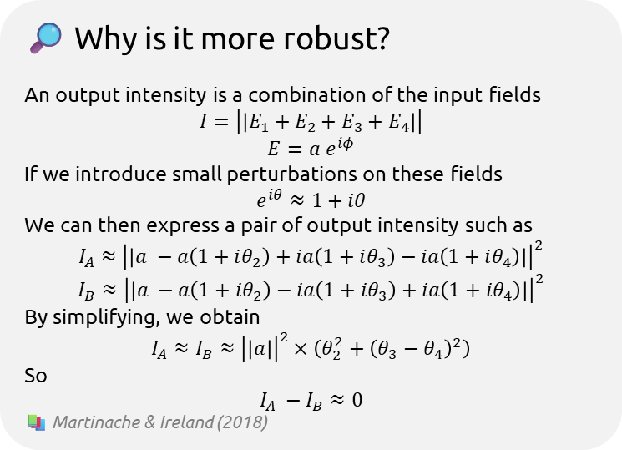
Kernel-Nulling
DIRECT DETECTION OF EXOPLANETS USING TUNABLE KERNEL-NULLING
Signals in phase quadrature
🔎 Why is it more robust?
An output intensity is a combination of the input fields
$$I=\left|\left|E_{1}+E_{2}+E_{3}+E_{4}\right|\right|$$
$$E=a e^{iφ}$$
If we introduce small perturbations on these fields
$$e^{iθ}≈1+iθ$$
We can then express a pair of output intensity such as
$$I_{A}≈{\left|\left|a −a\left(1+iθ_{2}\right)+ia\left(1+iθ_{3}\right)−ia\left(1+iθ_{4}\right)\right|\right|}^{2}$$
$$I_{B}≈{\left|\left|a −a\left(1+iθ_{2}\right)−ia\left(1+iθ_{3}\right)+ia\left(1+iθ_{4}\right)\right|\right|}^{2}$$
By simplifying, we obtain
$$I_{A}≈I_{B}≈{\left|\left|a\right|\right|}^{2}×\left(θ_{2}^{2}+{\left(θ_{3}−θ_{4}\right)}^{2}\right)$$
So
$$I_{A} −I_{B}≈0$$
📚 Martinache & Ireland (2018)
Difference between pairs of symmetric combinations
Robust to low order phase aberations

Slide 3
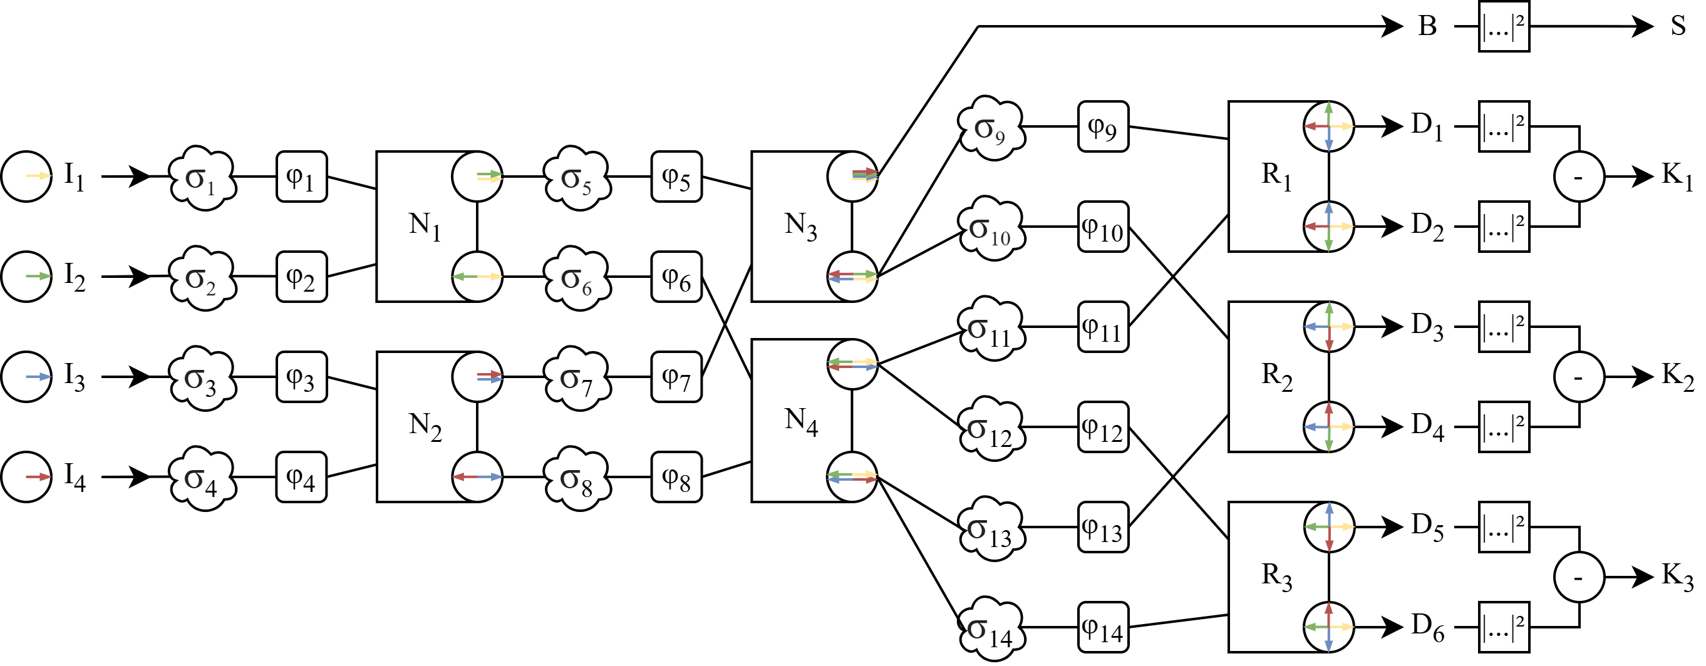
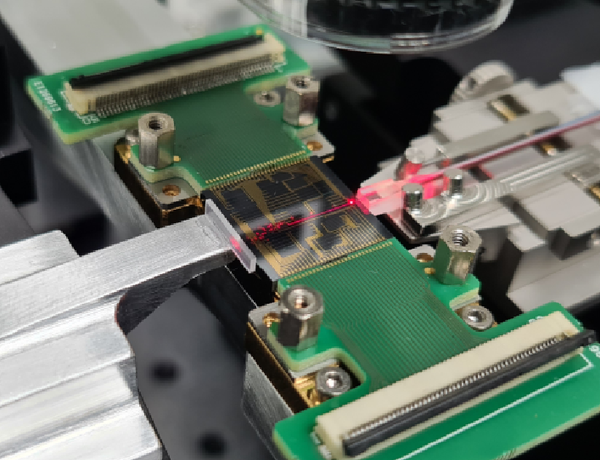
Tunable architecture
DIRECT DETECTION OF EXOPLANETS USING TUNABLE KERNEL-NULLING
4x7 operation exploded in a series of 2x2 MMI
Electro-optic phase shifter placed between all MMI
Photonic chip (16mm large)

